Slide 2
Within the coming weeks, many employees will be returning to the workplace, post-pandemic.
CDI World - USA has been working on ways to welcome employees back to their environment (including our own), with a renewed sense of inventiveness and optimism. In order to prompt a compassionate urgency, CDI World - USA has developed an affordable modular panel system to refresh common areas - lobbies, breakrooms, hallways, and conference rooms.

Slide 3
The modular lobby panels can accommodate temporary backlit messaging, graphic panels, or monitor screens to customize your company’s personal health and safety messages.
CDI World - USA has developed additional safety and wellness accessories for lobbies and common areas to facilitate more organized queueing initiatives - such as traffic flow barriers, sanitizing and mask/glove stations, and communication zones.
Enclosed are a few examples.

Slide 4
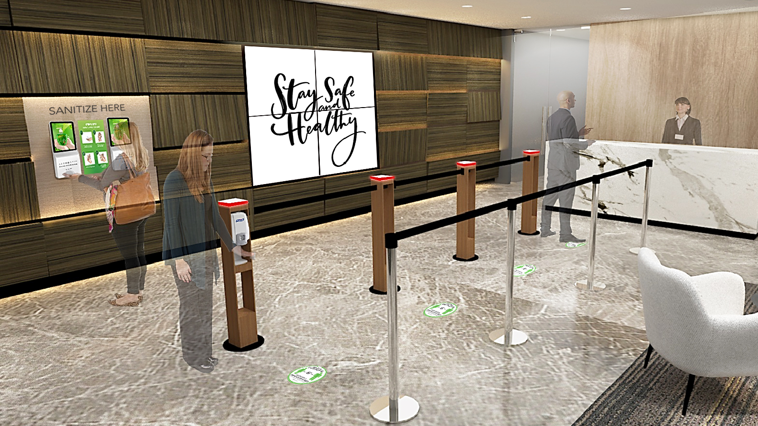
Updatable/removable backlit silicone-edge graphic or monitors for digital content option
Easy-to-sanitize surfaces
Retractable tension barrier
Multiple accessory options available: sanitizers, gloves, masks, and tissues
Modular Lobby Program

Slide 5
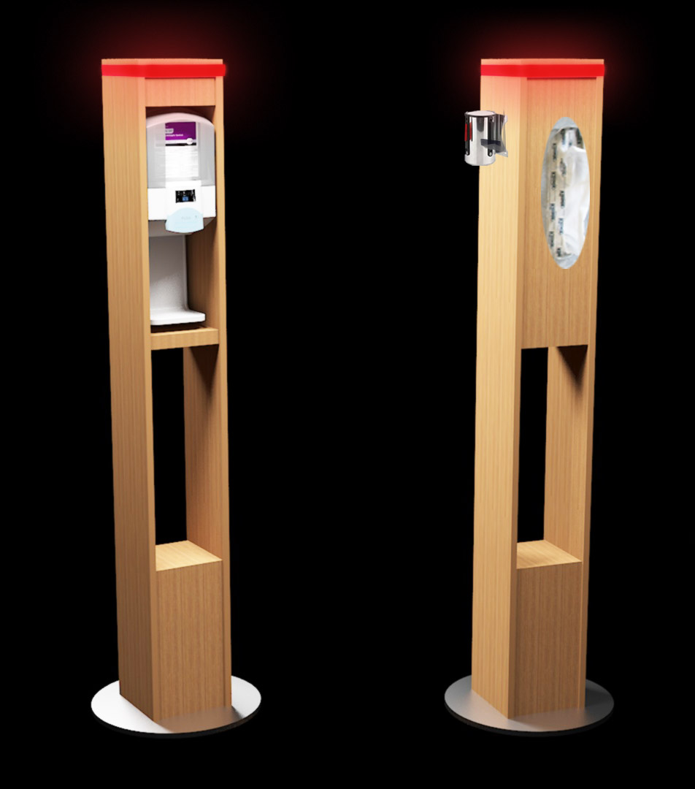
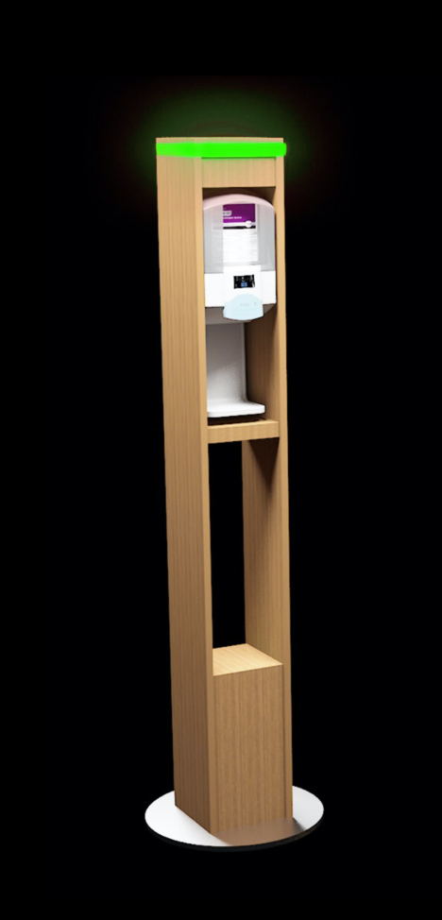
3’-7” Hts. QUEUE POLE SYSTEM – OPTION 1
Sensor Hand Sanitizer / Tissue Holder
Optional LED beacon to signal queue progression
Retractable tension barriers
Alternating LED signals queue progression
Multiple accessory options available for sanitizers, gloves, masks, or tissues
Designed for mobility when needed; ADA compliant
Easy-to-sanitize finishes; multiple finish options
Weighted base in powdercoat or stainless steel to match environments
Freestanding Queue Pylons

Slide 6
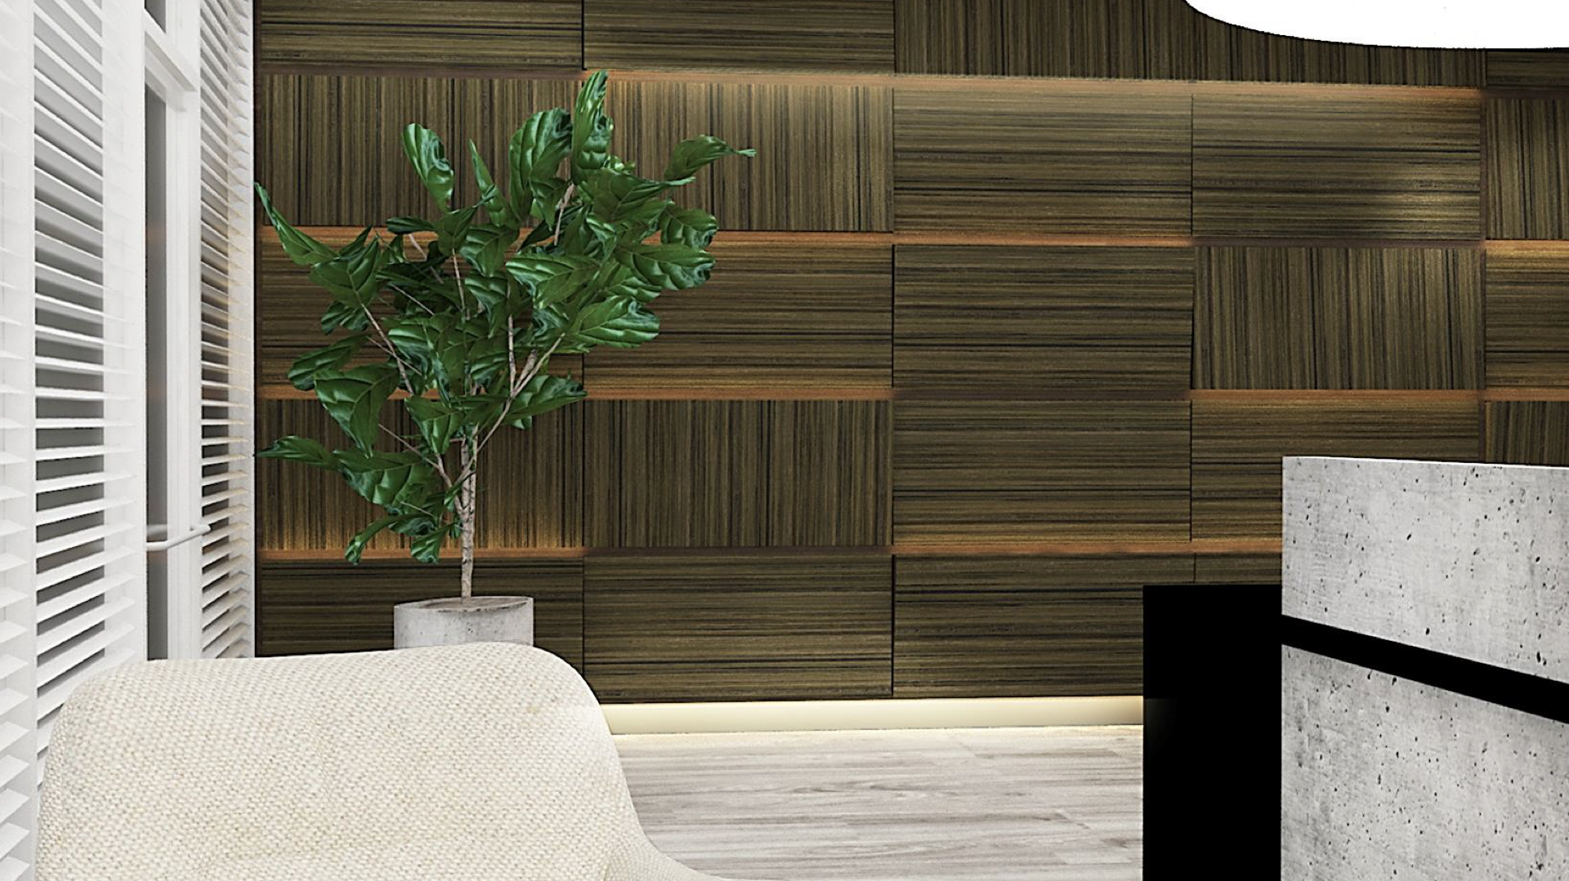
Modular panels shown with LED lighting option
Panels have multiple options for signage, accessories, shelving, lighting and electrical
Modular Wall Panels

Slide 7
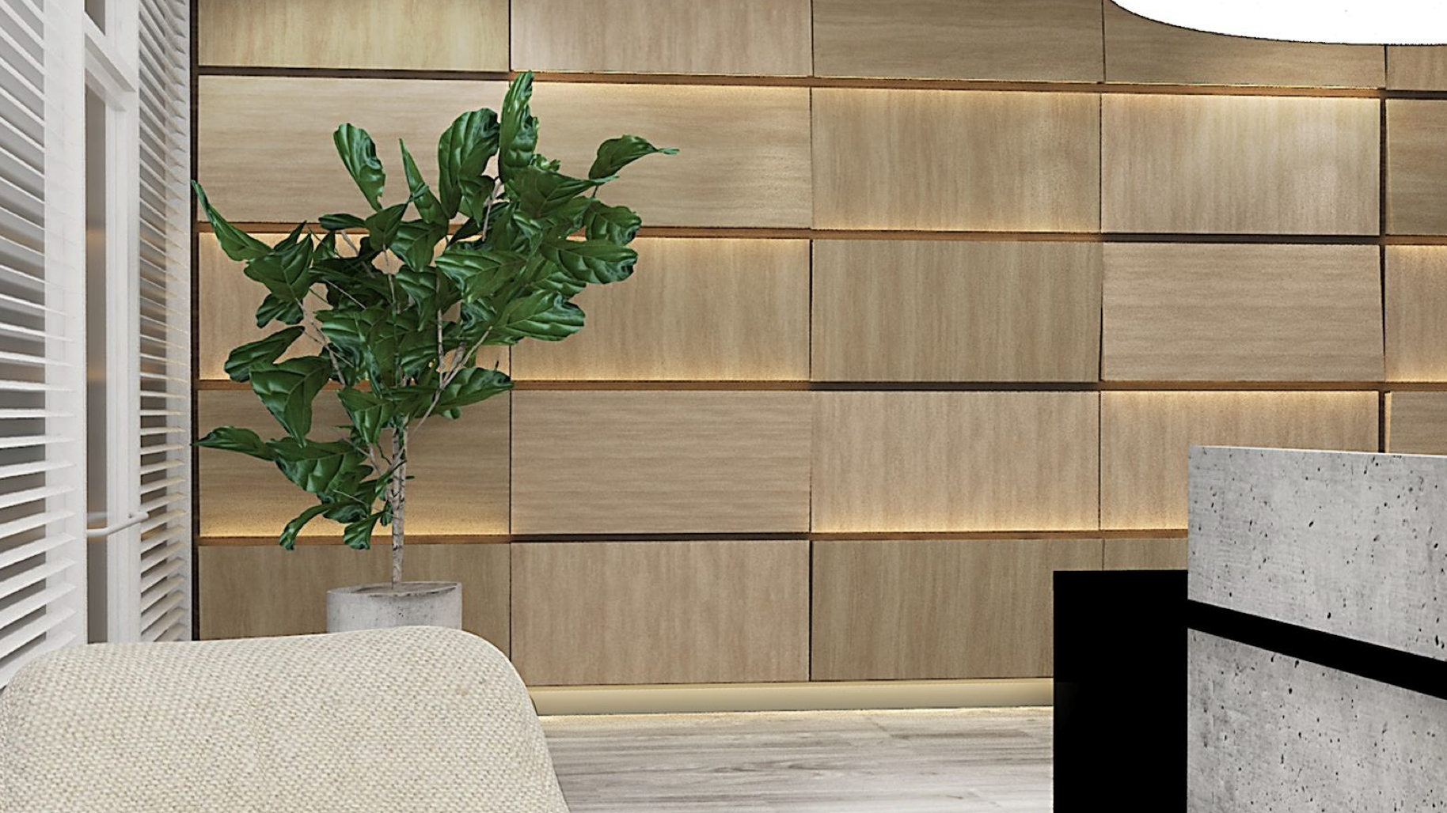
Multiple finish options available
Modular Wall Panels

Slide 8
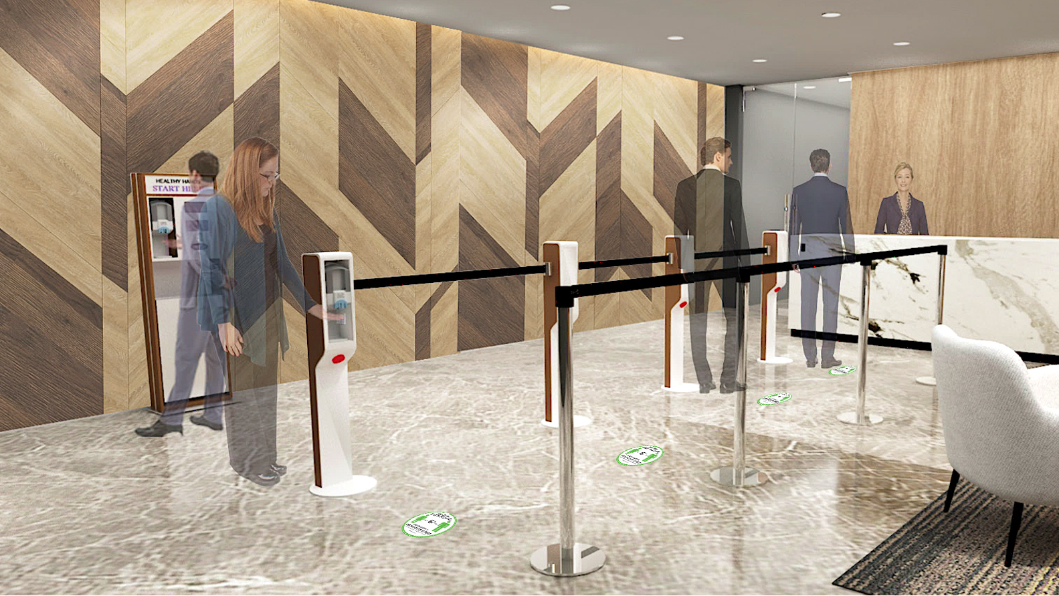
Easy-to-sanitize surfaces
Multiple accessory options available: sanitizers, gloves, masks, and tissues
Retractable tension barrier
Modular Lobby Program

Slide 9
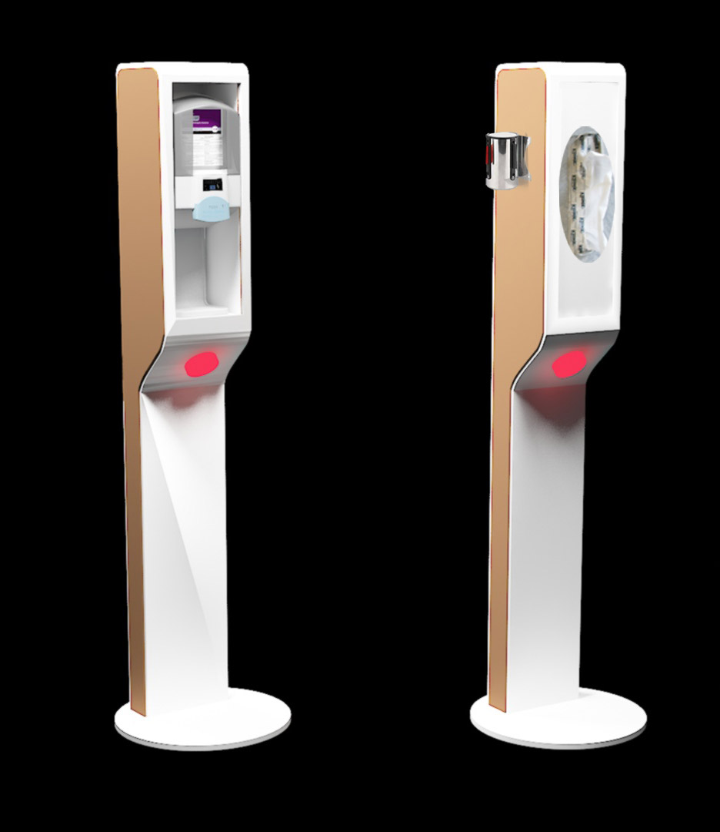
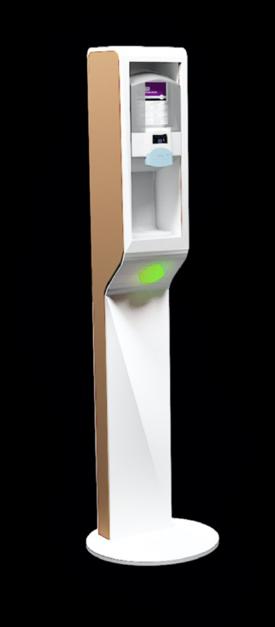
Designed for mobility when needed; ADA compliant
Retractable tension barriers
Multiple accessory options available for sanitizers, gloves, masks, or tissues
Optional LED beacon to signal queue progression
Alternating LED signals queue progression
Easy-to-sanitize finishes; multiple finish options
Weighted base in powdercoat for easy cleaning and stability
Freestanding Queue Pylons

Slide 10
Multiple finish options available
Modular Wall Panels

Slide 11
Thank you!
This presentation contains a mixture of copyrighted and non-exclusive materials. Copyrighted materials may hold the exclusive rights of CDI USA, Inc. or an affiliate partner. If you wish to replicate, distribute, or post any copyrighted material from this presentation, you must obtain permission in writing from the direct copyright owner.

